Slide 1
SPAM MAIL DETECTION
MACHINE LEARNING
PRESENTED BY:
PRIYANSHI GUPTA
AKSHIT MALIK

Slide 2









INTRODUCTION
Spam e-mails can be not only annoying but also dangerous to
consumers.
Spam e-mails can be defined as :
Anonymity
Mass Mailings
Unsolicited:
Spam e-mail are message randomly sent to multiple addressees by all sorts of groups, but mostly lazy advertisers and criminals who wish to lead you to phishing sites.

Slide 3











NAÏVE BAYS CLASSIFIER
Simple probabilistic classifier that calculates a set of probabilities by counting the frequency and combination of values in a given dataset.
Represent as a vector of feature values.
It is very useful to classify the e-mails properly
The precision and recall of this method is known to be very effective

Slide 4









PROBLEM STATEMENT
Unwanted e-mails irritating internet connection
Critical e-mail message are missed and / or delayed.
Millions of compromised computers
Billions of dollars lost worldwide
Identity theft
Spam can crash mail servers and fill up hard drives

Slide 5









OBJECTIVE
The objective of identification of Spam e-mails are :
To give knowledge to the user about the fake e-mails and relevant e-mails
To classify that mail spam or not.

Slide 6








SCOPE OF THE PROJECT:
It provides sensitivity to the client and adapts well to the
future spam techniques.
It considers a complete message instead of single words with respect to its organization.
It increases Security and Control.
It reduces IT Administration Costs.
It also reduce Network Resource Costs.

Slide 7








DOCUMENT PREPROCESSING
Tokenization
Tokenization is the process of breaking a stream of text up into words, phrases, symbols, or other meaningful elements called tokens.
The list of tokens becomes input for further processing such as
parsing or text mining.

Slide 8











LEMMATIZATION
Lemmatization in linguistics, is the process of grouping together the different inflected forms of a word so they can be analysed as a single item.
In computational linguistics, lemmatisation is the algorithmic
process of determining the lemma for a given word.

Slide 9

REMOVAL OF STOP WORD
Sometimes, the extremely common word which would appear to be of very little value in helping select documents matching user need are excluded from the vocabulary entirely.

Slide 10









REQUIREMENT ANALYSIS
Functional Requirement
To classify the e-mails which is done by first taking out the feature vector extraction which involves first taking out whether the word is a spam or not.
Non-Functional Requirement
Ensures high availability of email data here datasets. User should get the result as fast as possible.
It should be easy to use i.e., user is just required to type the words and click then the result is displayed or user is just required to enter a pair of reasonable sentence.

Slide 11




FEASIBILITY STUDY
Technical Feasibility
Economic Feasibility
Operational Feasibility

Slide 12






TESTING
we tested the datasets and found out which e-mail is spam
and which mail is non spam indicated as 0 and 1 respectively.
We calculated the feature vector to know whether it is spam or non-spam
Using that feature vector Naïve Bayes Algorithm works by comparing the trained data to test the data

Slide 13






DATASET
Dataset is a collection of data or related information that is
composed for separate elements.
A collection of dataset for e-mail spam contains spam and non-spam messages

Slide 14
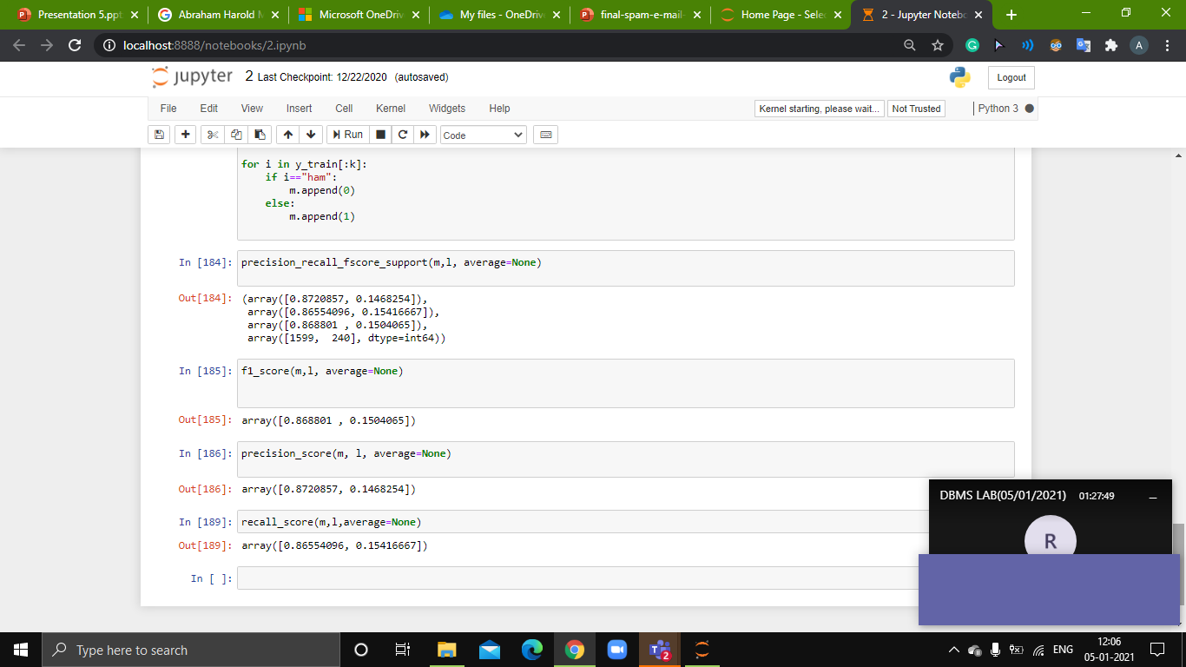

Slide 15







OUTPUT
Any external email can be detected and classified as spam e-
mail. So the users will be aware of such email.
Mails are classified into spam and non spam.
From the classified data we have calculated the accuracy greater than 87 %
Recall > 86.07%
F-measure > 86%

Slide 16



CONCLUSION
We are able to classify the emails as spam or non-spam. With high number of emails lots if people using the system it will be difficult to handle all possible mails as our project deals with only limited amount of corpus.

Slide 17





































REFERENCES
[1]Clemmer, A. (2012). How Bayesian algorithm works. [online] Available at: https://www.quora.com/How-do-Bayesian-algorithms-work-for-the- identification-of-spam [Accessed 16 Aug. 2017].
[2]What is Email Spam?. (2017). [Blog] comm100. Available at: https://emailmarketing.comm100.com/email-marketing-ebook/email- spam.aspx [Accessed 27 Aug. 2017].
[3]G. He, Spam Detection, 1st ed. 2007.
[4] bot2, V. (2017). Email Spam Filtering : A python implementation with scikit-learn. [online] Machine Learning in Action. Available at: https://appliedmachinelearning.wordpress.com/2017/01/23/email-spam- filter-python-scikit-learn/ [Accessed 30 Aug. 2017].

Slide 18
Thank You

